Slide 1
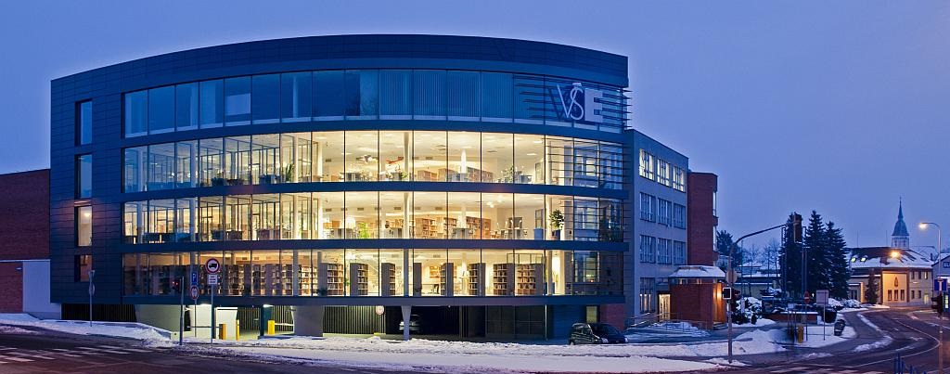
Faculty of management
University of Economics, Prague

Slide 2
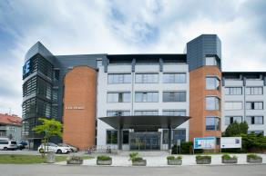
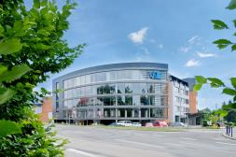
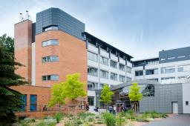
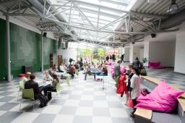


GENERAL INFORMATION
The Faculty offers bachelor's, master's and doctoral degree in management
  full time and combined forms
  modular form of study
The Faculty has a fully equipped and newly renovated facility
  main building, library and information centre, dorm complex and canteen
  modernization from EU funds – OP Research and Development for Innovation
The faculty offers its students
  environment of the largest and oldest Czech economics and management universities
  quality education at all three levels of university studies
  tailoring studies according to individual student needs
  extensive possibilities of studying abroad
  high rate of graduates working in the field
  new Library and Information Centre and renovated dorms
  study in homelike and friendly atmosphere in Jindřichův Hradec with a rich cultural and
  social life
1

Slide 3
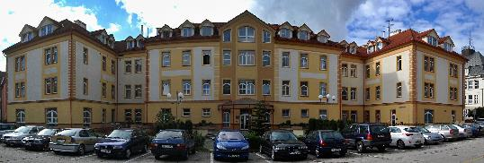
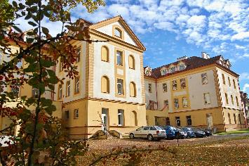

Dormitory AND CANTEEN
A 10-minute walk from the faculty building
  quiet part of the city centre
  all civic amenities in the vicinity
Sufficient capacity in dormitories : 343 beds
  cellular type of accommodation
Possibilities for sporting and social activities
Possibility to park directly in front of the dormitory
Canteen located in the dormitory
  two meals at a discounted price for students
2

Slide 4
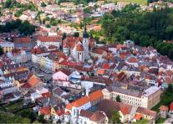
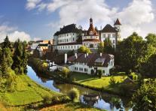
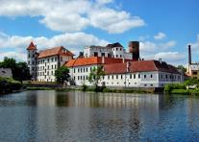
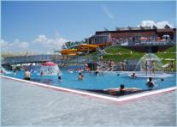
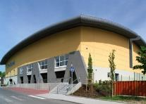
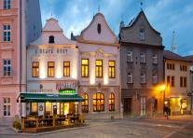


Jindřichův Hradec
Picturesque South Bohemian town with approximately 22,000 residents
Economic, administrative and cultural centre of the region
Good accessibility by car, bus or train
Quiet and very safe city
Well-preserved and popular historical centre
Healthy and beautiful scenery around the town (Czech Canada)
Sports and social facilities in the city
  sports stadium, sports hall, athletics stadium, swimming pool
  fitness centres, sports centres
  a dense network of bike and hiking trails
  cinema, theatre
  museums and galleries
  major cultural events throughout the year
Facilities for student life
  dozens of pubs and bars
  two discos
3

Slide 5
courses for exchange students
The exchange students can choose from ten courses taught in English
The courses cover topics from various spheres of management and marketing
  Operations Management: Soft and Hard Approaches
  Marketing
  International Management and Marketing
  Visual Qualitative Research Methods
  Sociology of Management and Organizations
  Management of Complexity
  Marketing Strategy
  Marketing Strategy Simulation
  Managerial Thinking and Decision-Making
  Consumer Culture, Media Technologies and Marketing Communication
Students can find full list of courses for exchange program here: https://www.fm.vse.cz/en/exchange-students/regular-courses/
Although the courses are suitable mainly for bachelor‘s students, we also welcome master‘s students as well
The courses are called only for the winter term (September – December)
4

Slide 6

Buddy program
Each of the Faculties of University of Economics, Prague has Buddies for students who arrive for an exchange program
Buddy from the Faculty of Management will
  Pick you up at the airport
  Show you round the city and the faculty
  Introduce you to your new colleagues
  Help you and advise you anytime you need to
With your Buddy you can
  Study
  Travel
  Party
  Just have a fun...
5

Slide 7
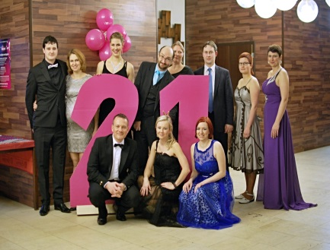

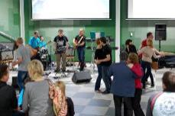
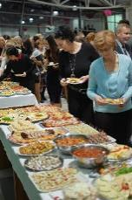
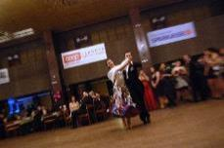

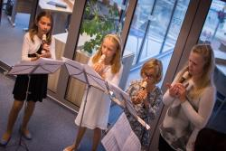
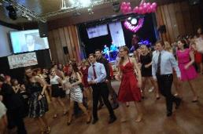
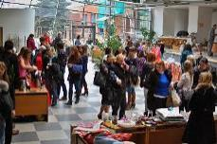
Social life
The Faculty of Management has a number of student organizations and clubs
  Theatre group FAMA
  the first Czech university sorority Alfa Fí
  student magazine PRIMETIME
  volunteer programme 5P
  student PR team
  student band
You can visit various social and cultural events every month
6

Slide 8
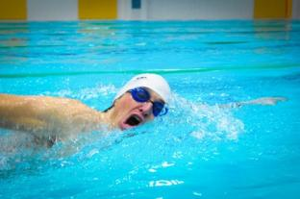


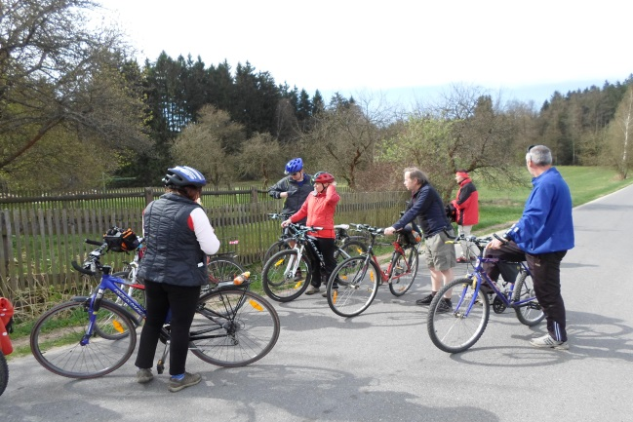
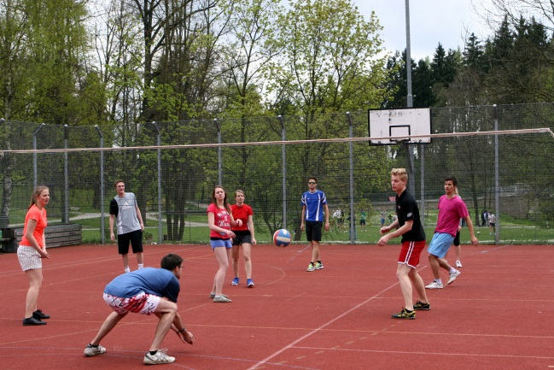
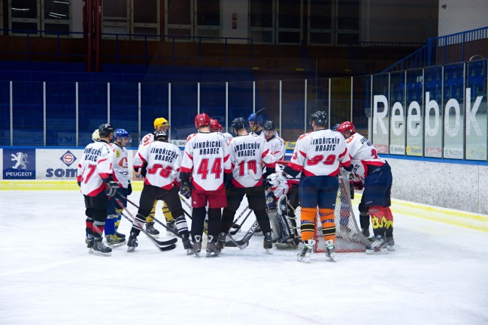
University sports club
University sports club organizes sports activities for students and faculty stafff
  offers nearly two dozen sports activities throughout the week during the semester
    i.e. aerobics, spinning, fit boxing, TRX, swimming, climbing, hockey, table tennis, basketball and many more
Organizes or co-organizes individual sporting events
  Christmas swimming relay, Hradec Jogging Hour, Skiing with the Faculty of Management, hockey and volleyball matches, Rector's Sports Day
The annual membership fee is only CZK 500 for students
7

Slide 9

Main Advantages for exchange Students
Faculty of Management
  Part of high-prestige University of Economics, Prague
  Holder of the ECTS Label
  Attractive list of courses for exchange students
  Recently renovated campus
  Excellent equipment for study and students life
  Small faculty with individual approach to students
  Friendly atmosphere
  Helpful staff
Jindrichuv Hradec
  Fully-equipped administrative center of the region
  Wide choice of free-time activities for students
  Convenient transportation to the city
  High-quality tourism destination
  Gate to Czech Canada Natural Park
  Friendly and safe city
  Low-living costs
  The best city for living in the Czech Republic (2011)

Slide 10
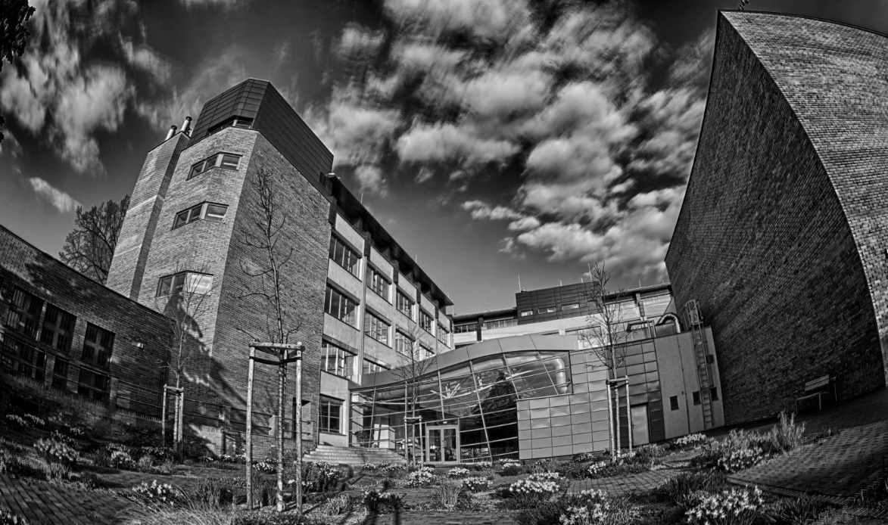


CONTACT INFORMATION
Faculty of Management
1117 Jarosovska Str., Jindrichuv Hradec, Czech Republic
00420 384 417 277
info@fm.vse.cz
http://www.fm.vse.cz
Martin Luštický
Vice-Dean for Development and External Relations
martin.lusticky@vse.cz
Daria Gunina
International Exchange Coordinator
daria.gunina@fm.vse.cz
9

Slide 11
We look forward to seeing you in Hradec!

